Slide 1
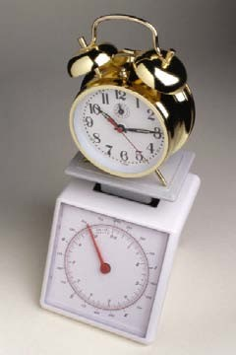
Scale: Definition
A measurement scale is a set of predefined symbols or values in order to represent certain common measures.
A scale is an abstract measurement tool for measuring defined common attributes of entities.

Slide 2
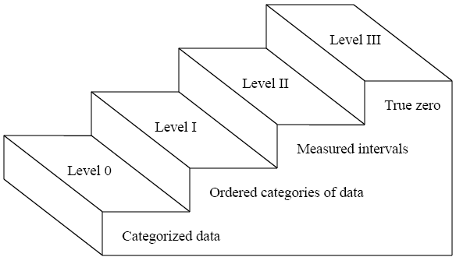
Scales
Ratio
Interval Ordinal
Nominal
One relational system is said to be richer than another if all relations in the second are contained in the first.

Slide 3

Measurement Scale: Questions
How do we determine when one numerical relation system is preferable to another? (pragmatic)
How do we know if a particular empirical relation system has a representation in a given numerical relation system? (representation problem)
What do we do when we have several diﬀerent possible representations (and hence many scales) in the same numerical relation system? (uniqueness problem)

Slide 4
Scale Types
Five scales
Nominal, ordinal, interval, ratio, absolute
Subjective scales: Subjective scale measurement refers to measures that have to do with what people say they actually experience.
Example: Likert-Type scale (Evaluation-Type, Frequency-Type, Agreement-Type)
Semantic differential scale
Notes:
assessment of workload, fatigue, usability, annoyance and comfort

Slide 5
Nominal Scale
we define classes or categories, and then place each entity in a particular class or category, based on the value of the attribute.
Characteristics
The empirical relation system consists only of diﬀerent classes; there is no notion of ordering among the classes.
Any distinct numbering or symbolic representation of the classes is an acceptable measure, but there is no notion of magnitude associated with the numbers or symbols.
Nominal-scale measurement places elements in a classification scheme. The classes are not ordered; even if the classes are numbered from 1 to n for identification, there is no implied ordering of the classes.

Slide 6








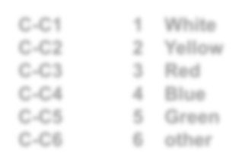
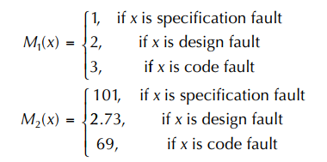

Nominal Scale: Example
Classification of cars based on their colour.
Classification of faults in a software:
Specification fault
Design fault
Coding fault
Entity
Attr
Car
Colour
C-C1 C-C2 C-C3 C-C4 C-C5 C-C6
White
Yellow
Red
Blue
Green
other
Measure (Car Colour) ∈ {“1”, “2”, “3”, “4”, “5”, “6”}
{White, …, other}

Slide 7
Ordinal Scale
The ordinal scale is useful to augment the nominal scale with information about an ordering of the classes or categories.
Characteristics
The empirical relation system consists of classes that are ordered with respect to the attribute.
Any mapping that preserves the ordering (i.e., any monotonic function) is acceptable.
The numbers represent ranking only, so addition, subtraction, and other arithmetic operations have no meaning

Slide 8







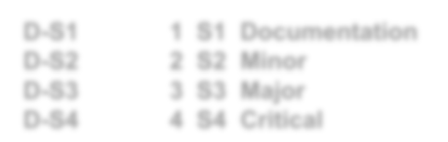

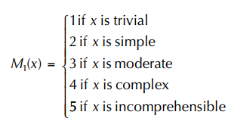
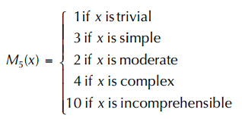
Ordinal Scale: Example
Entity
Attr
Measuring complexity of many software modules by defining 5 complexity classes
Trivial
Simple
Moderate
Complex
Incomprehensible
Defect
Severity
D-S1 D-S2 D-S3 D-S4
S1 Documentation
S2 Minor
S3 Major
S4 Critical
Measure (Defect Severity) ∈ {S1, …, S4}
{1, …, 4}
Not Valid
Valid

Slide 9
Interval Scale
Interval scale carries more information than ordinal and nominal scale. It captures information about the size of the intervals that separate the classes, so that we can in some sense understand the size of the jump from one class to another.
Characteristics:
An interval scale preserves order, as with an ordinal scale.
An interval scale preserves differences but not ratios. That is, we know the difference between any two of the ordered classes in the range of the mapping, but computing the ratio of two classes in the range does not make sense.
Addition and subtraction are acceptable on the interval scale, but not multiplication and division.

Slide 10
Interval Scale: Example
M’ = aM + b
Project scheduling
Requirement analysis 4 weeks start at July 1
Design 4 weeks
Coding 4 weeks
Testing
When testing starts? After 12 weeks

Slide 11
Ratio Scale
Sometimes we would like to be able to say that one liquid is twice as hot as another, or that one project took twice as long as another. This needs the ratio scale, which is the most useful scale of measurement, and quite common in the physical sciences.
Characteristics:
It is a measurement mapping that preserves ordering, preserves size of intervals between entities, and preserves ratios between entities.
There is a zero element, representing total lack of the attribute.
The measurement mapping must start at zero and increase at equal intervals, known as units.
All arithmetic can be meaningfully applied to the classes in the range of he mapping.

Slide 12







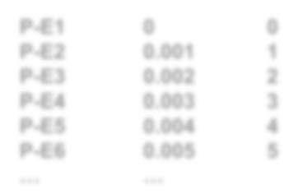


Ratio Scale: Example
Entity
Attr
Measuring length, distance, etc.
preserves M’ = aM
Measuring execution time of a program
Measuring length of software code
LOC
thousands of LOC
The number of characters contained in the program
the number of executable statements
Prog
Exec Time
0
1
2
3
4
5
P-E1 P-E2 P-E3 P-E4 P-E5 P-E6
…
0
0.001
0.002
0.003
0.004
0.005
…
Measure (Progr. Exec. Time) ∈ [0, ∞)

Slide 13
Absolute Scale
The absolute scale is the most restrictive of all. For any two measures, M and M', there is only one admissible transformation: the identity transformation.
Characteristics:
The measurement for an absolute scale is made simply by counting the number of elements in the entity set.
The attribute always takes the form “number of occurrences of x in the entity.”
There is only one possible measurement mapping, namely the actual count, and there is only one way to count elements
All arithmetic analysis of the resulting count is meaningful.

Slide 14






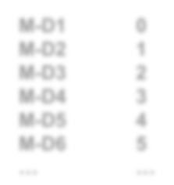


Absolute Scale: Example
M’ = M
Number of failures observed in a module is absolute but the reliability is not.
Number of people working on a project is absolute but their productivity is not.
^{Entity} Attr
Module
#Defects
M-D1 M-D2 M-D3 M-D4 M-D5 M-D6
…
0
1
2
3
4
5
…
Measure (Module Defect Count) ∈ IN₀

Slide 15
Summary
Nominal scale: classification of objects, where the fact that objects are different is preserved
Ordinal scale: objects are ranked/ordered according to some criteria, but no information about the distance between the values is given
Interval scale: differences between values are meaningful
Ratio scale: there is a meaningful “zero” value, ratios between values are meaningful
Absolute scale: no transformation (other than identity) is meaningful

Slide 16
Measurement Scale Types
Scale Type | Characterization | Example (generic) | Example (SE)
Nominal | Divides the set of objects into categories, with no particular ordering among them 1–1 mapping from M to M′ | Labeling, classification of entities | Name of programming language, name of defect type
Ordinal | Divides the set of entities into categories that are ordered M to M′ with order | Preference, ranking, difficulty | Ranking of failures (as measure of failure severity)
Interval | Comparing the differences between values is meaningful M′ = aM + b (a > 0) | Calendar time, temperature (Fahrenheit, Celsius) | Beginning and end date of activities (as measures of time distance)
Ratio | There is a meaningful “zero” value, and ratios between values are meaningful M′ = aM (a > 0) | Length, weight, time intervals | Lines of code (as measure of attribute “Program length/size”)
Absolute | There are no meaningful transformations of values other than identity M′ = M | Object count | Count (as measure of attribute “Number of lines of code”)

Slide 17

Subjective Scale (Rating)
Likert Scale
Agreement-type Give the respondent a statement with which to agree or disagree. Example: This software program is reliable.
Evaluation-type
Example: Familiarity with and comprehension of the software development environment (e.g., compiler, code generator, CASE tools):
Little
Unsatisfactory
Satisfactory
Excellent

Slide 18

Subjective Scale (Rating)
Frequency-type
Example: Example: How often does this program fail?
Semantic Differential Scale: Items which include semantic opposites
Do you think code change tracking is important to find bug?

Slide 19
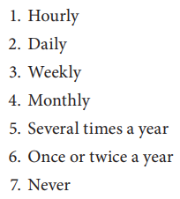
Subjective Scale (Rating)
Ordinal Scale List several ordered alternatives and have respondents select one.
For example: How often does the software fail?

Slide 20
Subjective Scale (Rating)
Assigning Numbers to Scale Responses:
Likert-Type Scales: Ordinal Scale
But: Often the distances between the four response categories are approximately (conceptually) equidistant and thus are treated like approximate interval scales
Semantic Differential Scale: Ordinal scale,
but again, often treated as interval scales

Slide 21
Exercise
Determine the best “scale” for each of the following measurements using each of the Nominal, Ordinal, Interval and Ratio scales only once.
Measuring execution time of a program
Classification of objects based on their color
Measuring duration of various phases of projects (Project scheduling)
Measuring complexity of many software modules by defining 4 complexity classes (Trivial, Simple, Moderate, Complex)
Ratio
Nominal
Interval
Ordinal

Slide 22
Exercise
Software products categorized according to their compatibility with the operating system (i.e. Windows, Linux, MacOS, DOS, etc.).
Internet services categorized according to their relevant technologies (i.e. dial-up, DSL, high-speed, wireless, etc.)
Measuring attitudes towards an Internet service (say, on an n-point rating, n = 0 to 10)
Measuring attitude towards Internet services, if the evaluation scores are numerically meaningful so the difference between a rate of 3 and a rate of 6 is exactly the same as the difference between a rate of 7 and a rate of 10.
Measuring attitude towards Internet services, if the differences between the data values are numerically meaningful and equal. In addition, a score of zero implies either the full absence of the service being evaluated or the full dissatisfaction with it.
Nominal
Nominal
Ordinal
Interval
Ratio

Slide 23
Exercise
Suppose that you are asked to study various software development tools and recommend the best three to your company. The following table shows a list of available development tools.
Tool Name/Vendor | Languages Supported | Platforms | Features
Bean Machine IBM | Java | Windows, OS2, Unix | Best: Visual applet and JavaBean generation
CodeWarrior Pro Metrowerks | Java, C, C++, Pascal | Unix, Windows, Mac | Best: if you need to support Unix, Windows, and Mac platforms
Java Workshop Sun Microsystems | Java | Solaris, Windows | Better: Written 100% in Java; tools based on a web browser metaphor
JBuilder Imprise | Java | Windows, AS400 | Better: database support
Visual Cafe for Java Symantec | Java | Windows | Good: multithreaded debugger
VisualAge IBM | Java | Unix, Windows | Good: includes incremental compiler and automatic version control
Visual J++ Microsoft | Java | Windows | Fair: All the bells and whistles for Windows

Slide 24
Exercise
What are the entities, attributes and their values in your model?
Entity | Attribute | Value
Development Tool | Language supported | Java, C, C++, Pascal
 | Platform | Win, Unix, Mac, OS2, AS400
 | Feature | Fair, Good, Better, Best

Slide 25
Exercise
What is the best scale for each of the attributes you defined?
Entity | Attribute | Value | Scale
Development Tool | Language supported | Java, C, C++, Pascal | Nominal
 | Platform | Win, Unix, Mac, OS2, AS400 | Nominal
 | Feature | Fair, Good, Better, Best | Ordinal

